Slide 1

SPORTS MANAGEMENT SYSTEM PROJECT PRESENTATION
NAME: OKINYO OGUTU

Slide 2
ABOUT
SPORTS CLUB Management System is a sports and health club membership management system where you can keep records on your members and have quick and easy communication between you and your members .
SPORTS Management also includes a booking system and has a range of reports that help in the management of the club.
It provides lots of function such data entry of customer , keeping record of all the things about customers fees , plan , physical fitness which help to provide good quality of services to customer from club managers .

Slide 3
Objectives of the Sports Club Management System
The main objective of the project is to develop a software that facilitates the data storage , data maintenance and its retrieval in an igneous way.
To develop easy to use software which handles the customer-staff relationship in a effective manner.
To develop a user friendly system that requires minimal user training . Most of features and function are similar to those on any windows platform.
Only the staff has the privilege to access any database and make the required changes , if necessary.

Slide 4
HARDWARE & SOFTWARE
Hardware Interface:
Hardware requirements for running this project are as follows :
Processor: - Pentium I or above.
RAM: - 128 MB or above.
HD: - 20 GB or above.
Software Interface:-
Software required to make working of product is :
Front end- PHP
Back end- MySql
Server - XAMPP

Slide 5
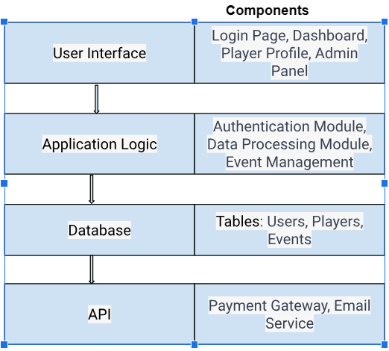
ARCHITECTURE

Slide 6
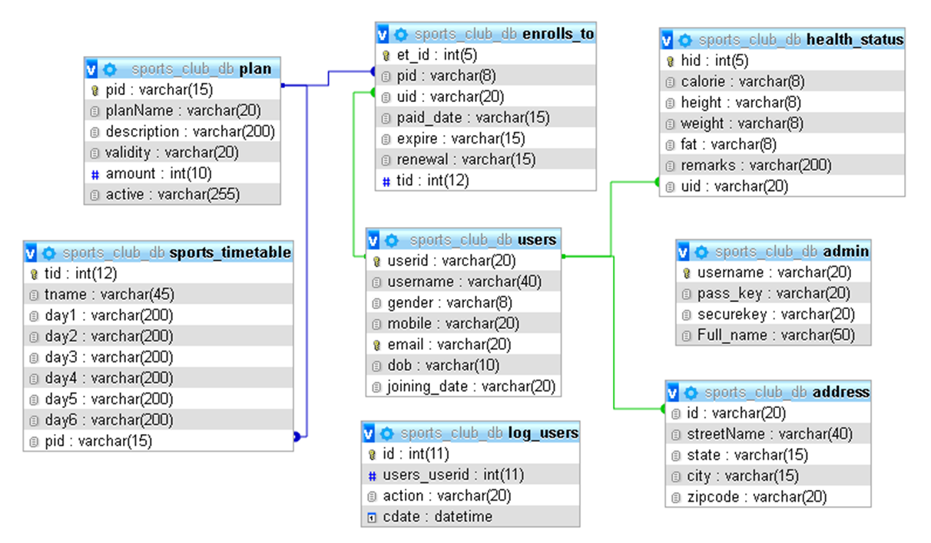
SCHEMA DIAGRAM

Slide 7
NORMALIZATION
Database Normalization is a technique of organizing the data in the database. Normalization is a systematic approach of decomposing tables to eliminate data redundancy(repetition) and undesirable characteristics like Insertion, Update and Deletion Anomalies. It is a multi-step process that puts data into tabular form, removing duplicated data from the relation tables.
Normalization is used for mainly two purposes :
Eliminating redundant(useless) data.
Ensuring data dependencies make sense i.e data is logically stored.

Slide 8
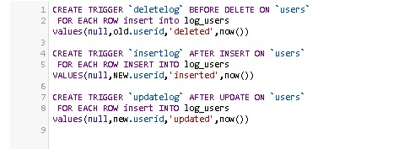
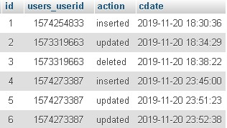
TRIGGERS
A trigger is a set of actions that are run automatically when a specified change operation (SQL INSERT, UPDATE, or DELETE statement) is performed on a specified table. Triggers are useful for tasks such as enforcing business rules, validating input data, and keeping an audit trail.

Slide 9
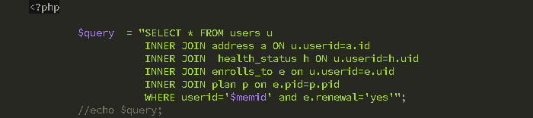
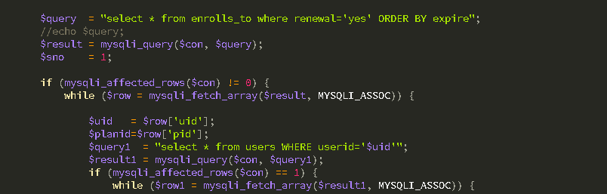
QUERIES

Slide 10
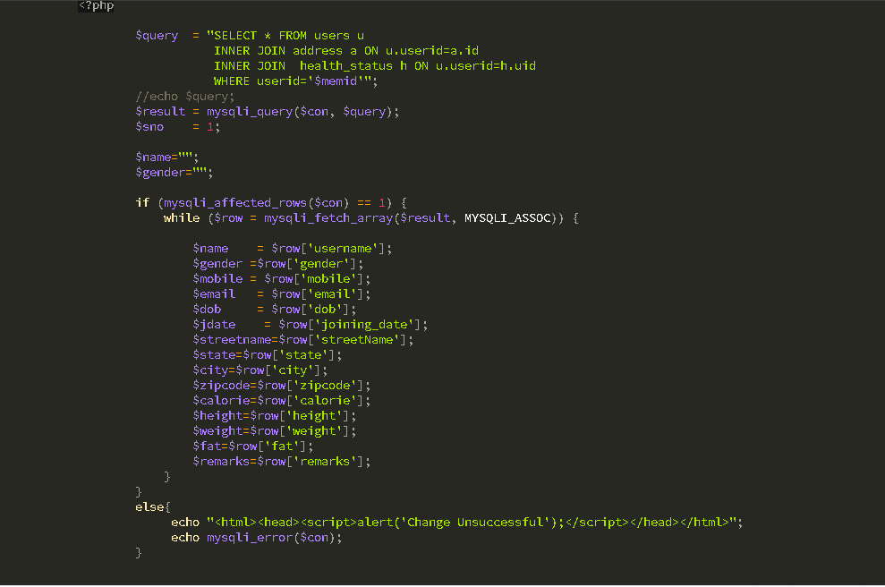
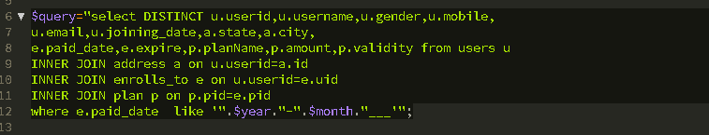

Slide 11
CHALLENGES; SOLUTIONS
User testing reveals that certain features or UI elements aren't as intuitive as initially thought; Considering user-friendly interfaces, tooltips, and tutorials within the application
Limited availability of specific hardware, software, or expertise, leading to delays or the need for creative workarounds; Considering outsourcing specific tasks or bringing in temporary expertise. Explore alternative technologies or approaches that may require fewer resources
Data inconsistencies, inaccuracies, or unexpected data scenarios may arise during actual usage; Data validation and cleaning procedures.

Slide 12
Technical learnings
Explored advanced frontend techniques like state management

Slide 13
CONCLUSION
After implementing the application it will contain the advantages that are incomparable to the present contemporary systems used by companies. The most admirable feature founded was its simplicity in terms of application to the user but its highly beneficial outputs can’t be ignored. The users will be highly benefited after using the system.
After modifying some techniques of the programs, it will give us the best performance as our requirements. The project will be very useful for the users.

Slide 14
Contact Information
E-mail: okiogutu@gmail.com
Phone: +254711205157
Github

Slide 15
Collaboration
Collaboration: Okinyo Ogutu
Timeline:
Planning and design:
Development:
Testing:

Slide 16
Q & A

